Slide 1

Xiangyu Zeng
BA 501

Slide 2


1.Business Problem 2.Project Description 3.Data Preprocessing & Exploratory analysis 4.Data Modeling and Comparison 5.Results and Conclusions 6. Suggestions and Recommendations

Slide 3
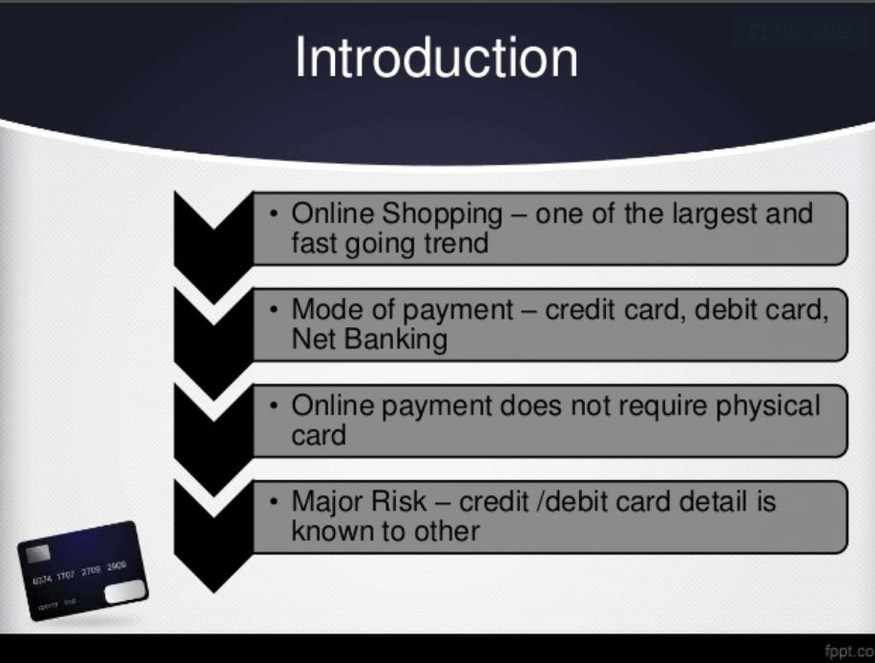

Slide 4
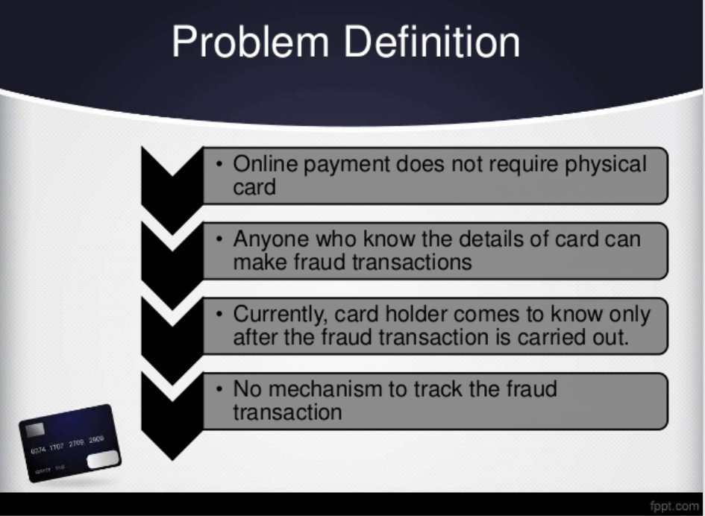

Slide 5
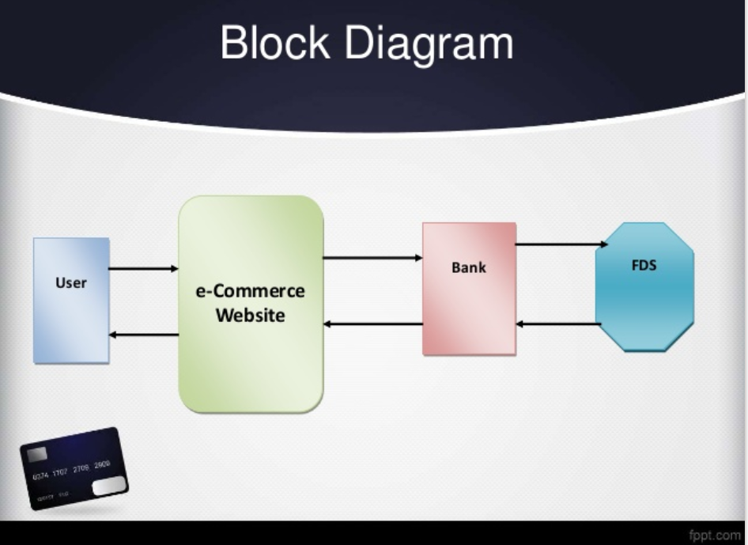
1.Fruad detected before transaction
2.Fruad detected after transaction

Slide 6

`
Problem:
1. Human evaluation for every case (Not realistic)
2. Machine detection & techniques (Accuracy)
• This Project: Random Forest & Logistic regression & SVM
• Higher level: Clustering & Hidden Markov Chain & Fixed rules
Chanllenges:
1.Difficulty in matching Fruad pattern
2.Confidentiality & Limitated amount of data

Slide 7
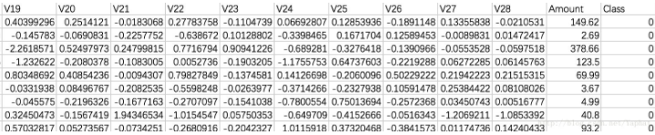
1. Data Set Description
Credit card records with 492 frauds out of 284,807 transactions(Result of a PCA transformation.)
Features : Time, V1, V2, ... V28, Amount and Class (0- Normal / 1-Fruad).

Slide 8
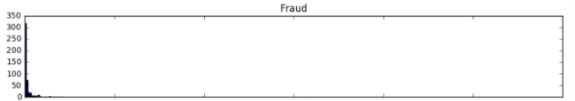
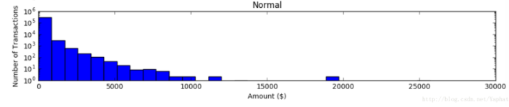
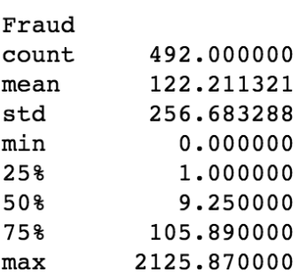
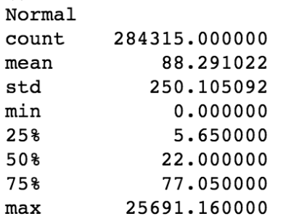
2. Data Visualization(1)
Most Fruads happens with small transactions amount.

Slide 9
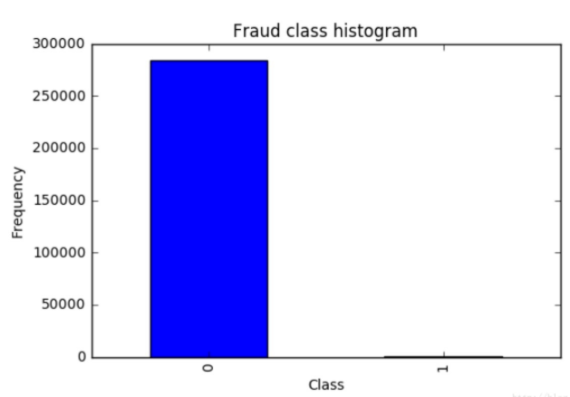
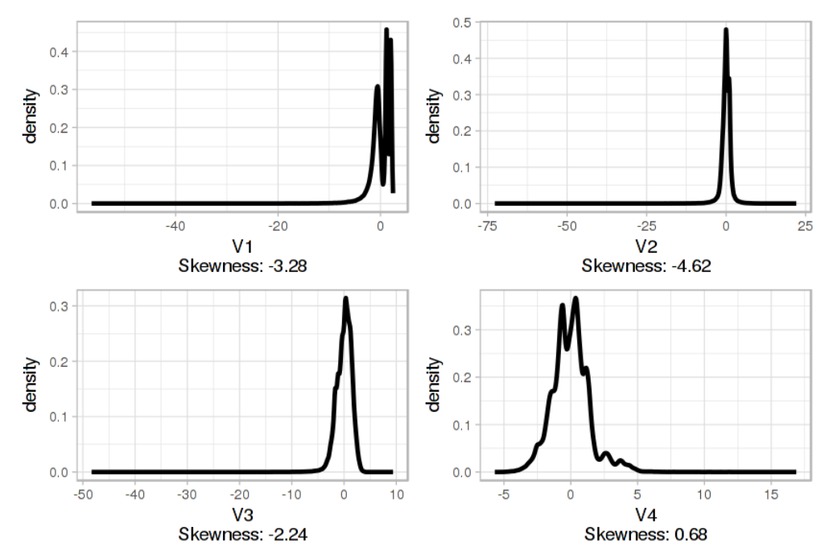
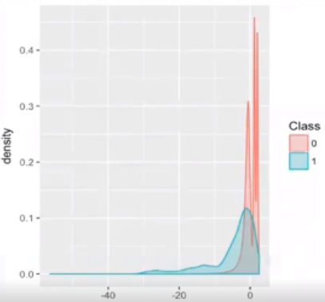
2. Data Visualization(2)
Issue: Class Imbalance|Solution: SMOTE Issue: Skewness|Solution: Box-Cox

Slide 10
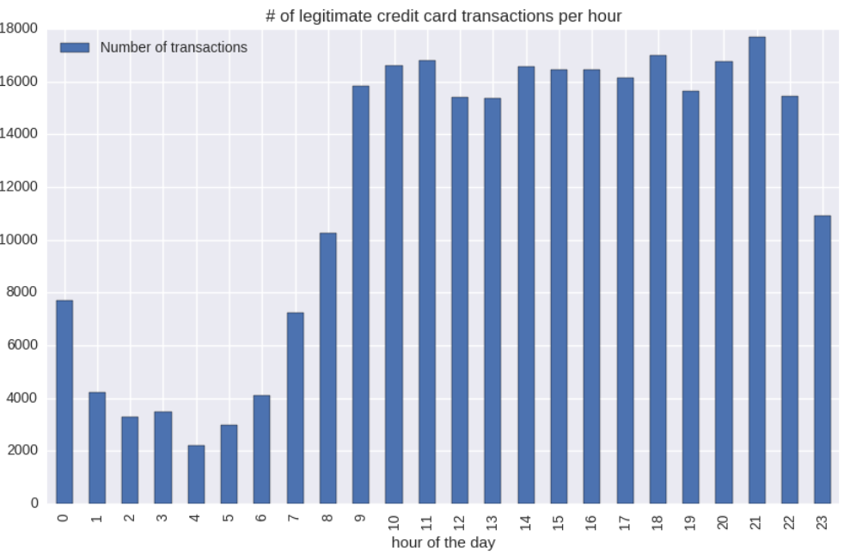
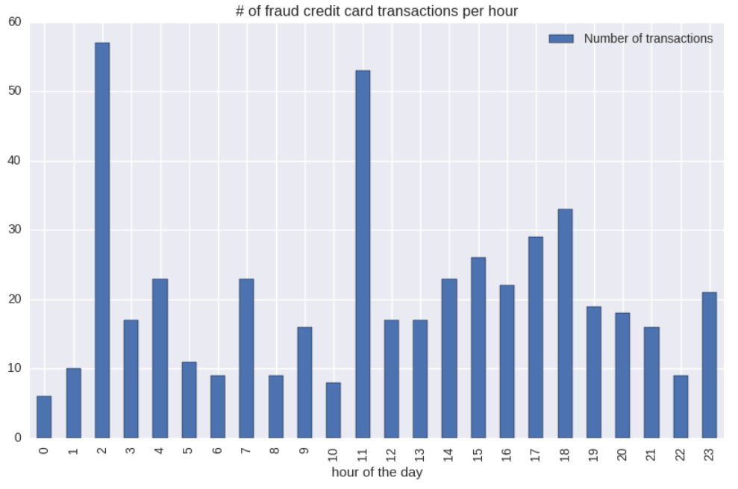
2. Exploratory data analysis(1)
The numbers of legitimate & Fruad card transactions with respect to time follow no obvious pattern

Slide 11
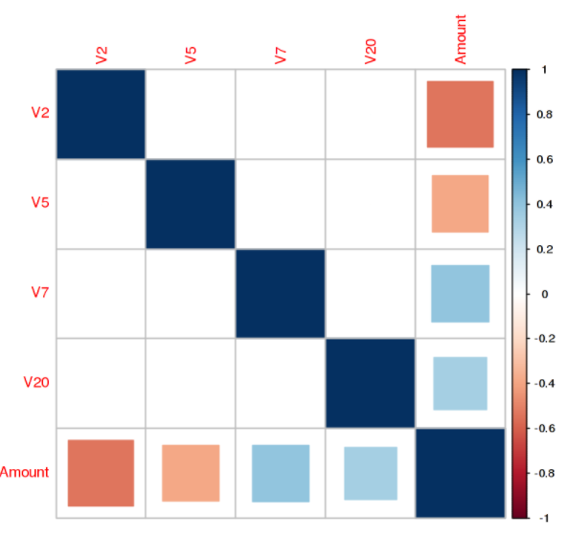
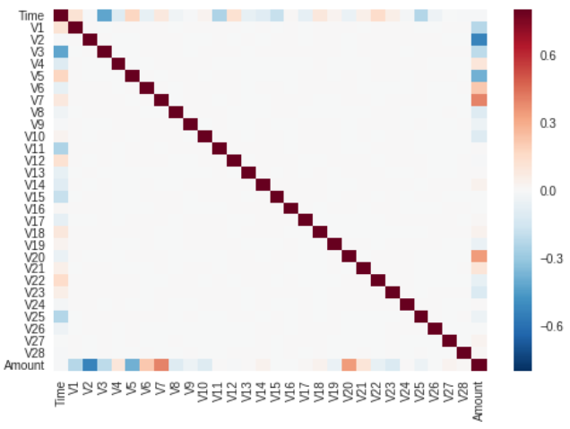
2. Exploratory data analysis(2)
Heat Map
V2, V5, V7 and V20 have higher correlations

Slide 12
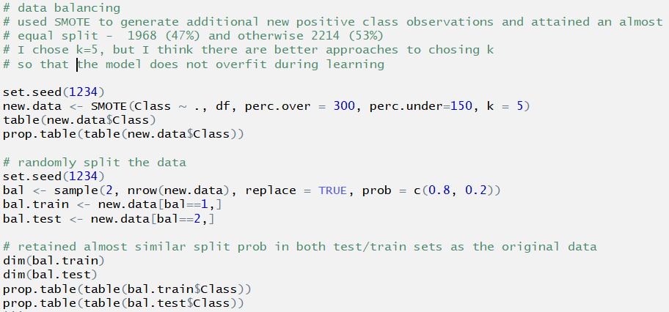
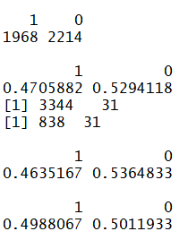
3. Data transformation
1.Box-Cox Transformation [Solve Skewness Problem]
2.Smote for Training & Testing dataset [To make Data More balanced ]
Smote Results (Unsolved Issue with determining the K-value)

Slide 13
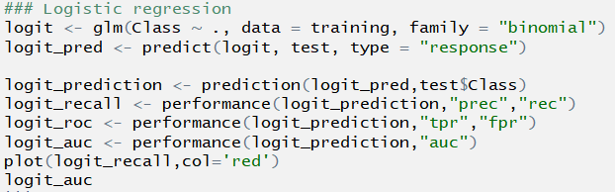
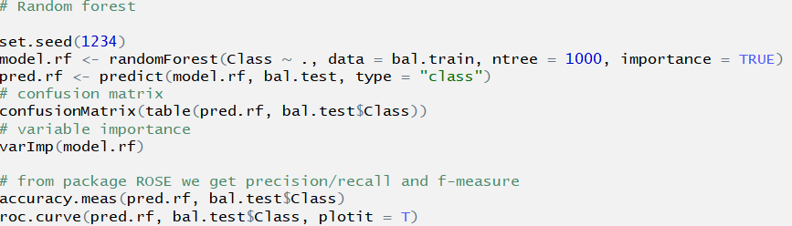
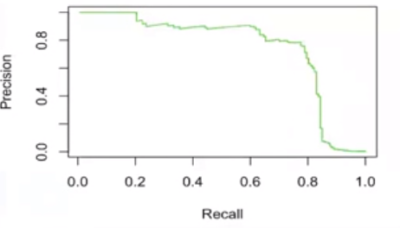
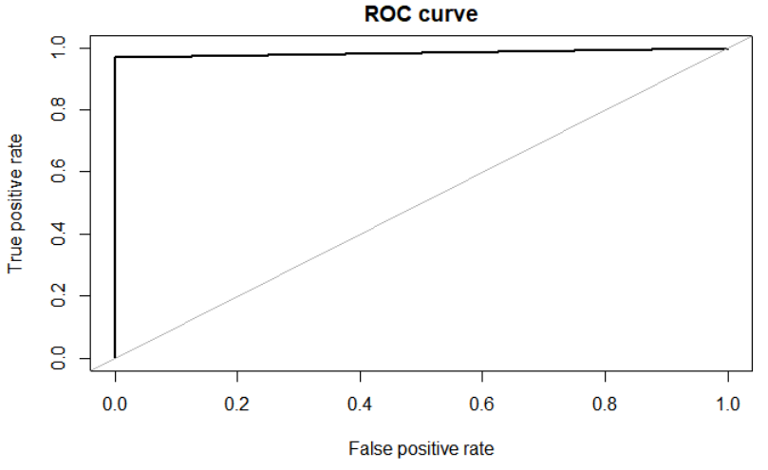
4. Data Modeling
1.Logistic Regression
2. Random Forest
Base Accuracy = 97.4%
AUC ROC Curve = 97.5%
AUC Value:

Slide 14
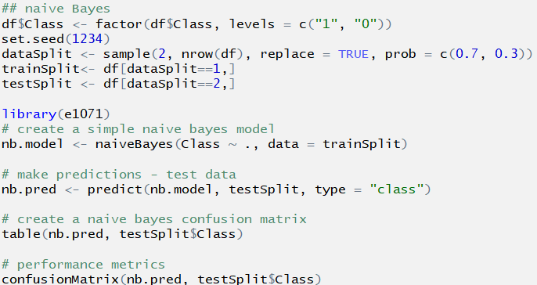
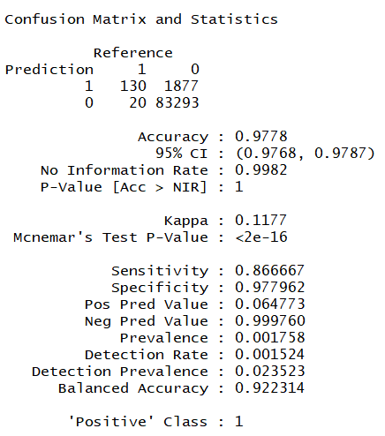
4. Data Modeling
3. Naive Bayes
Results
Base Accuracy = 97.8%
Sensitivity: 0.86
Specificity:0.97
Notes:
SMOTE:split the data to 7:3

Slide 15
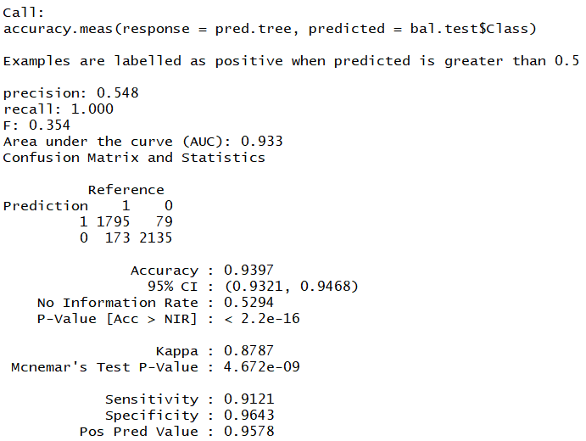
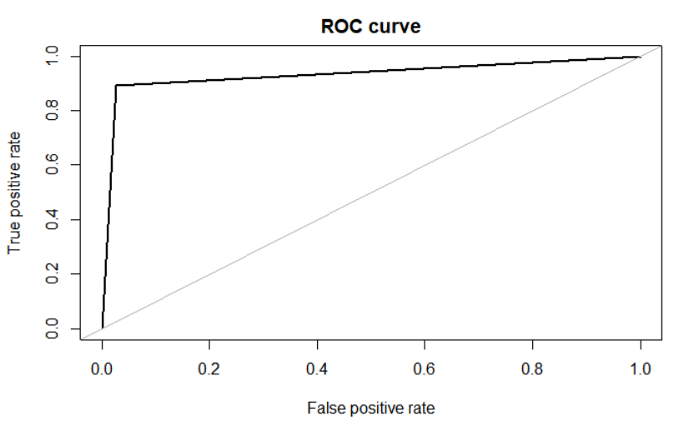
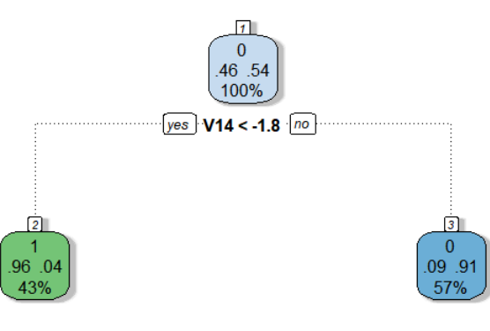
4. Data Modeling
4.Decision Tree
AUC Value: 93.97% Sensitivity:91.21% Specificity: 96.43%
Notes:
SMOTE:split the data to 7:3

Slide 16

5. Results and Suggestions
Among the four models, Random Forest and Naive Bayes have particularly high Accuracy, AUC, Sensitivity and Specificity values. Therefore, I would consider applying any of those two models for fruad detection.
6. Limitations
•Choosing K values in Smoting process
•PCA Performed on the given data set

Slide 17
7. Recommendation & Suggestion
Goal1: Reduce False Positive Rate
Goal2: Reduce Costs
Net Gain = Gain by less fraud - Investment in reducing Fraud
Sol: Machine learning techniques for Detection + Human processing

